Slide 2
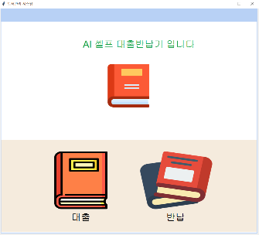
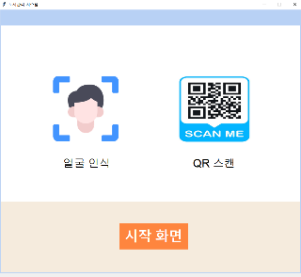
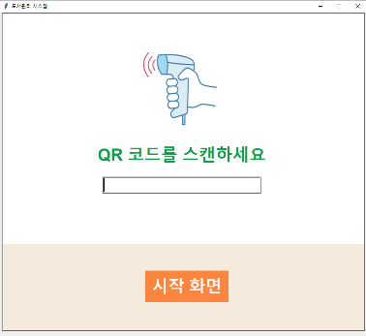
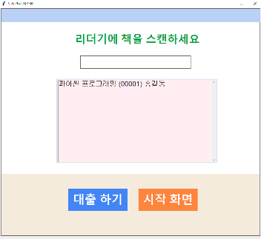
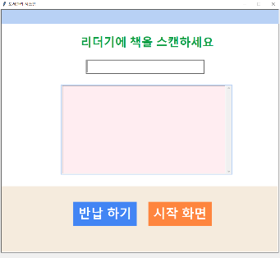
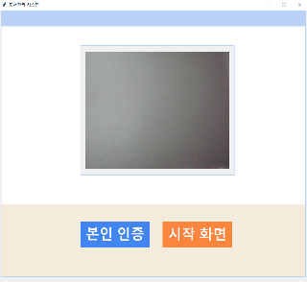
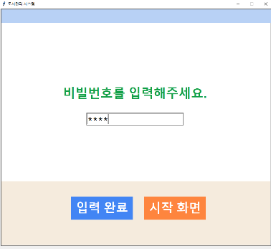

Slide 3
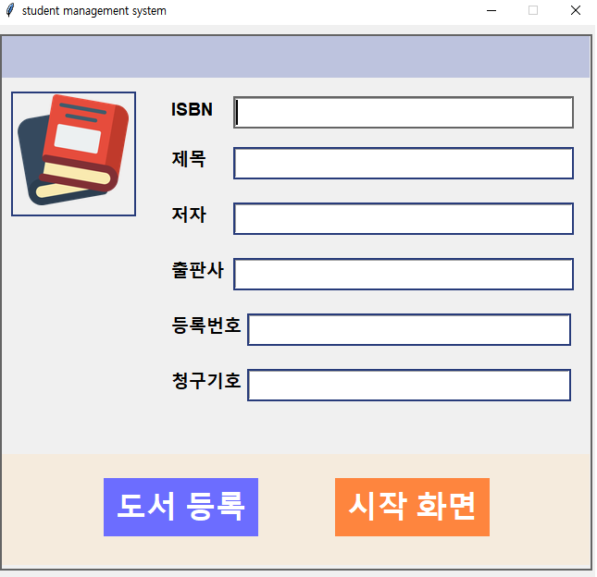
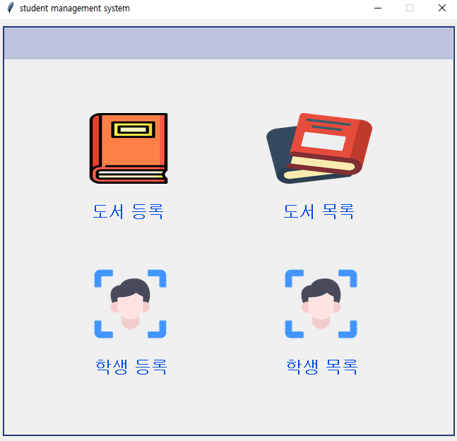
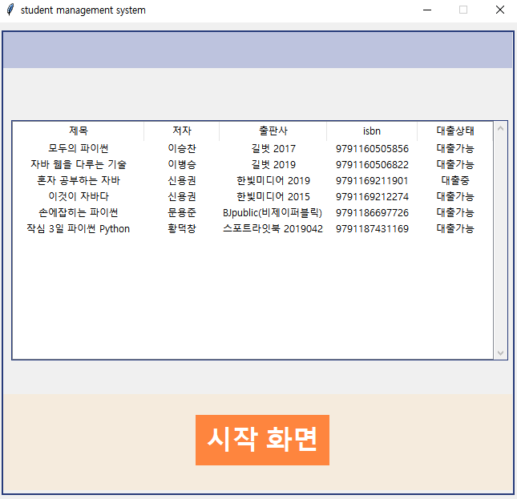
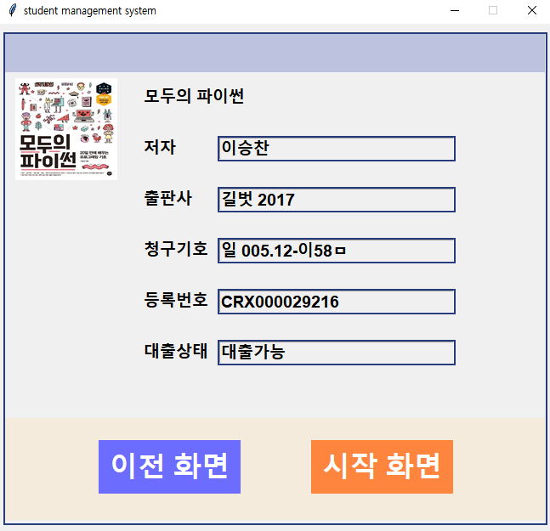
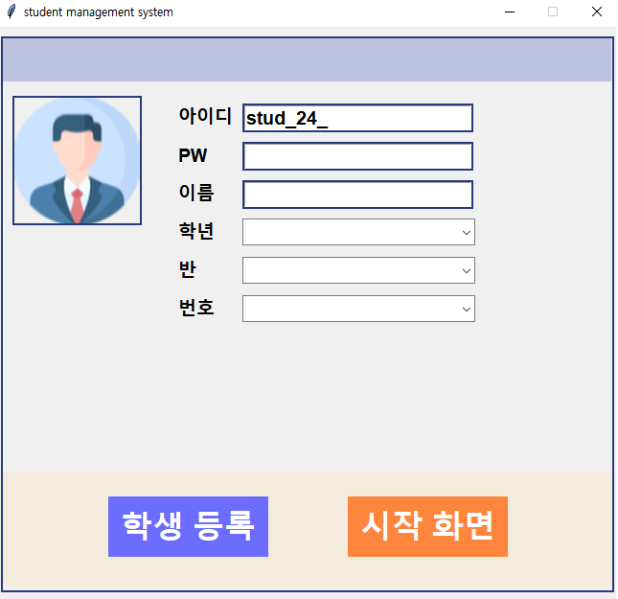
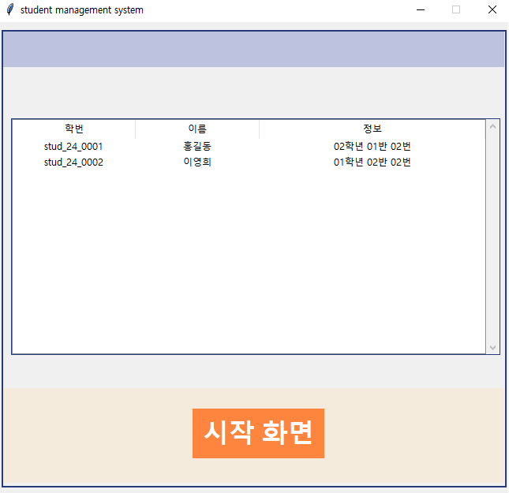

Slide 4
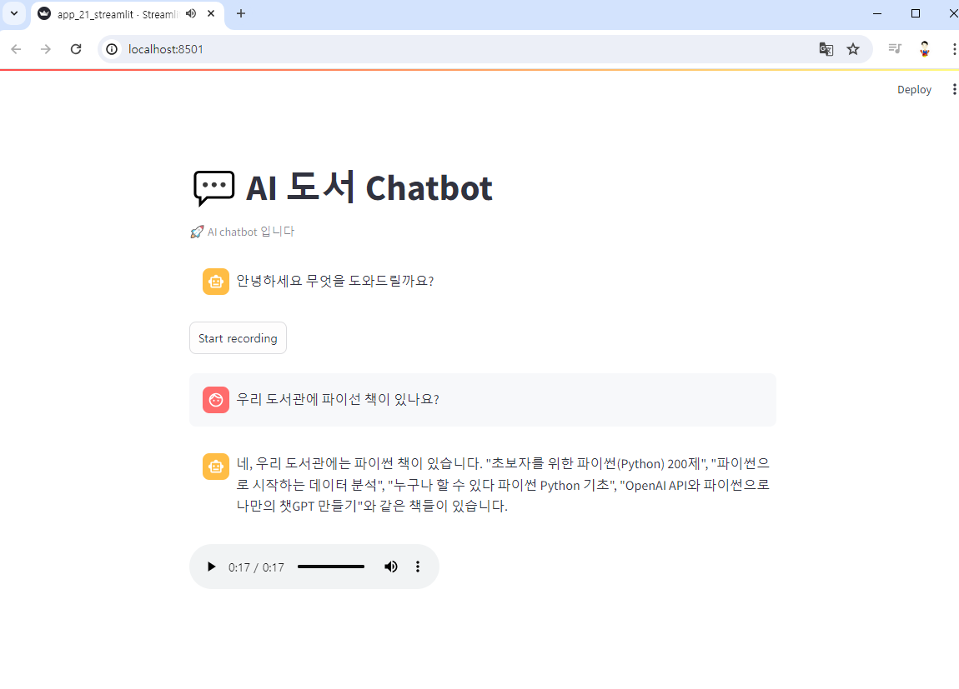
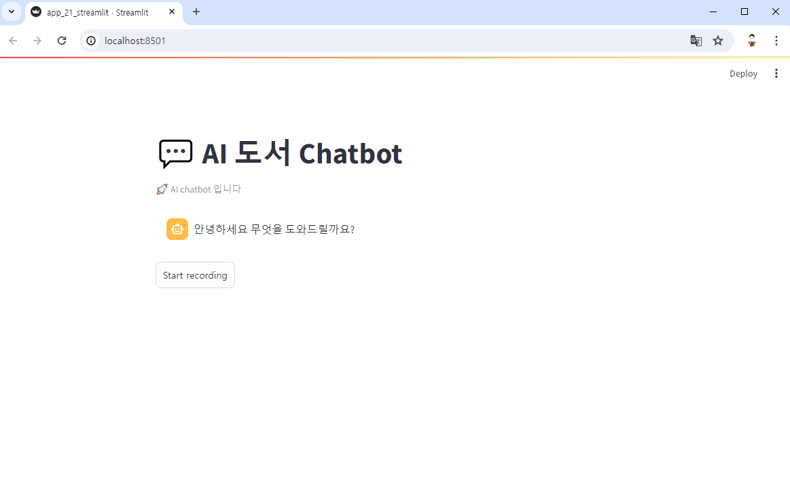

Slide 5





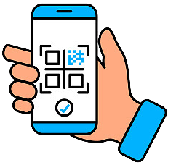




face recognition
Cloud Storage
QR SCAN
embedding
VectorDB
+ OpenAI
Python program
Chatbot

Slide 6
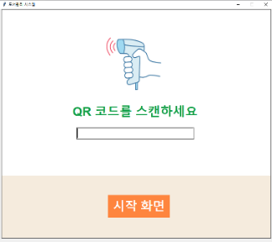
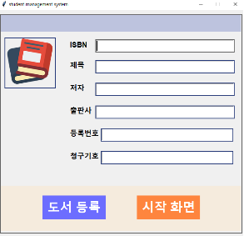
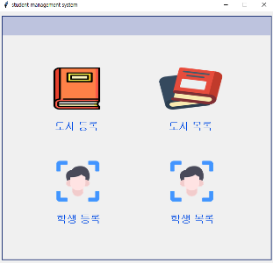

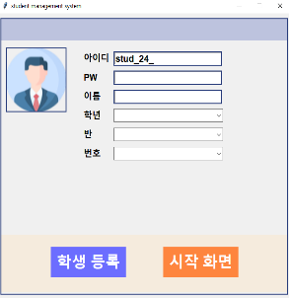
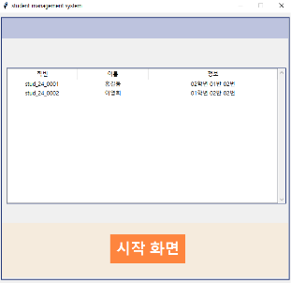
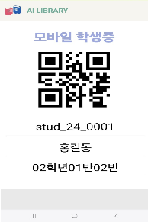



face recognition
Cloud Storage
Python program
QR SCAN
isbn SCAN
isbn SCAN
embedding
isbn SCAN
VectorDB
Python program
앱인벤터
Chatbot
+ OpenAI

Slide 7
face recognition
Cloud Storage
Python program
앱인벤터
QR SCAN
isbn SCAN
isbn SCAN
embedding
VectorDB
isbn SCAN
Python program
Chatbot
+ OpenAI

Slide 8


Cloud Storage
embedding
QR SCAN
face recognition
VectorDB
앱인벤터
음성 Chatbot
streamlit
+ OpenAI
isbn SCAN
isbn SCAN
isbn SCAN
검색 API
Python program
Python program

Slide 9
Python program – 도서 대출
Python program – 도서, 학생 관리

